Slide 1


Business Requirements
Help the business find out if there is a Correlation between
Weather conditions, and Bikes usage
e.g., Do rainy days result in less bikes hiring compared to sunny days?
Bikes Usage
Weather condition

Slide 2
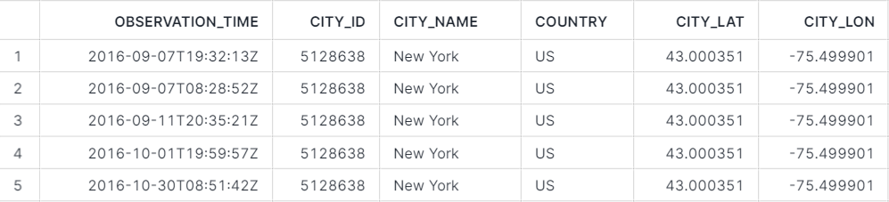
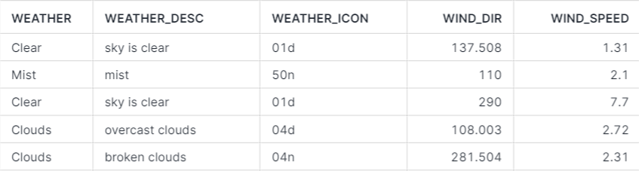
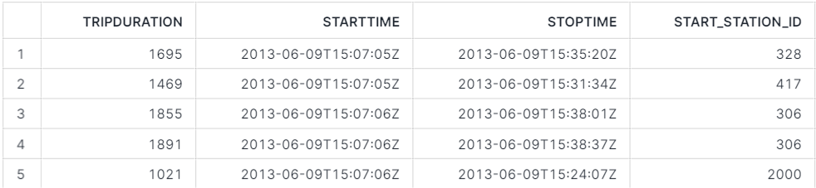
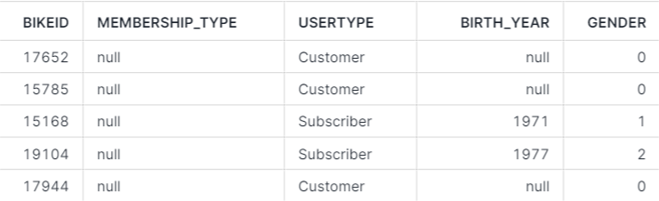
Data Realities
Data Profiling
Weather data
S3 bucket: s3://snowflake-workshop-lab/weather-nyc
Bike data
S3 bucket: s3://snowflake-workshop-lab/citibike-trips

Slide 3
Technical Architecture - Abstract
External
Data Sources
Raw Data
Ingest

Slide 4
Technical Architecture - Abstract
External
Data Sources
Raw Data
Prepared Data
Ingest
Process

Slide 5

Technical Architecture - Abstract
External
Data Sources
Raw Data
Prepared Data
Report
Ingest
Process
Analyze

Slide 6




Technical Architecture - Products
External
Data Sources
Raw Data
Prepared Data
Report
EL
T

Slide 7


Snowflake – Setting up the Environment
Creating the Warehouse
Create the Databases
Create the Schemas
Create the Tables

Slide 8


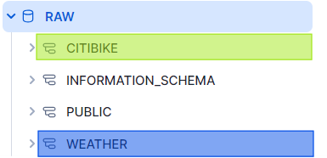
Snowflake – Ingesting the Data
Create Stages
Create External
EL
Ingest Data into Corresponding Tables

Slide 9
Dbt Cloud – Transforming the Data
Raw Data
Prepared Data
T

Slide 10
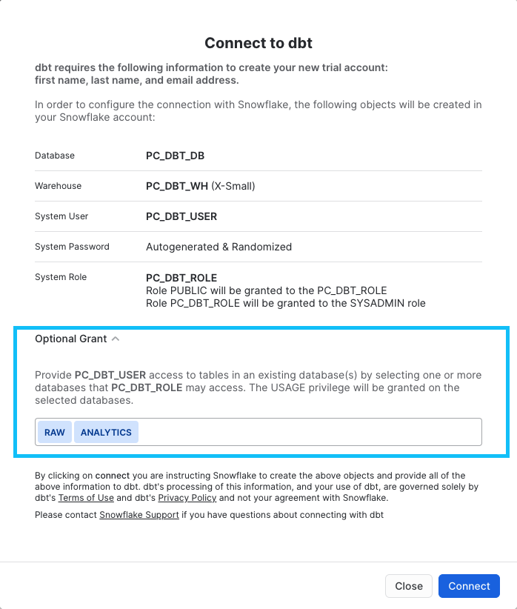
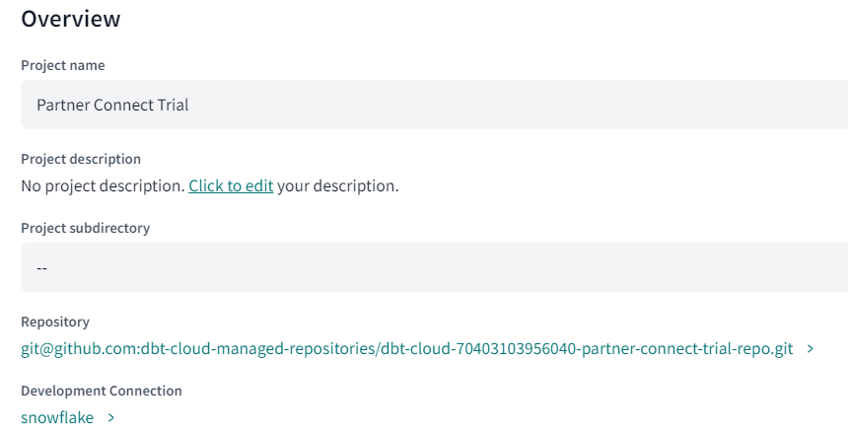
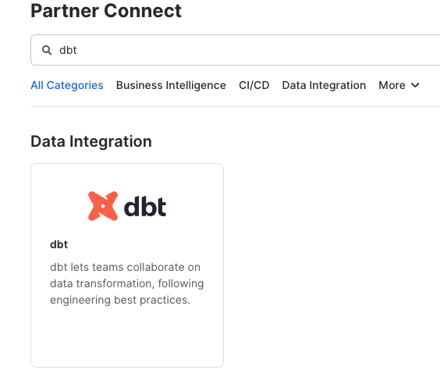
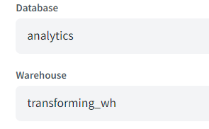
Dbt Cloud – Connect to Snowflake via Partner Connect
Step 1
Step 2
Step 3

Slide 11
Dbt Cloud – Ideas to fulfill the Business Requirement
The number of trips within months:
Are bikes used more in February or June, or September maybe?
The average trip duration/distance within a specific period of time
Are trips longer in February compared to June?
Bikes Usage
The number of trips by weather condition:
Are bikes used more when the weather is sunny or rainy?
Weather condition

Slide 12
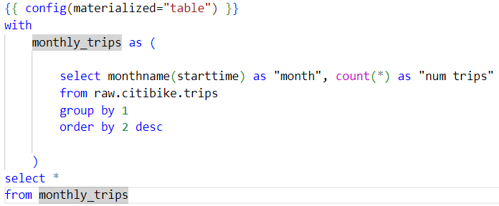
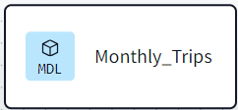
Dbt Cloud – Building your Models
The number of trips within months
Trips
Monthly_Trips
T

Slide 13
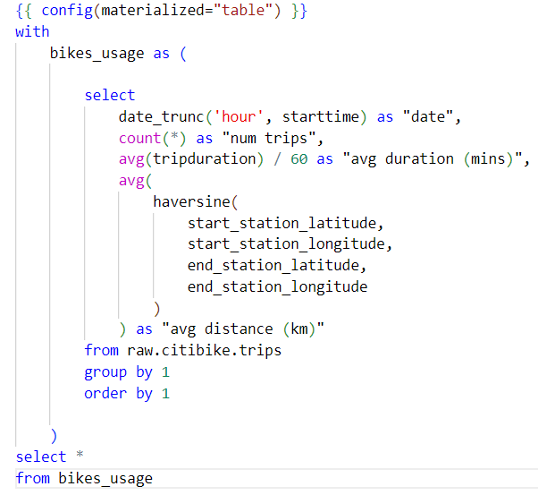
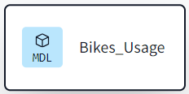
Dbt Cloud – Building your Models
The average trip duration/distance within a specific period of time
Trips
Bikes_Usage
T

Slide 14
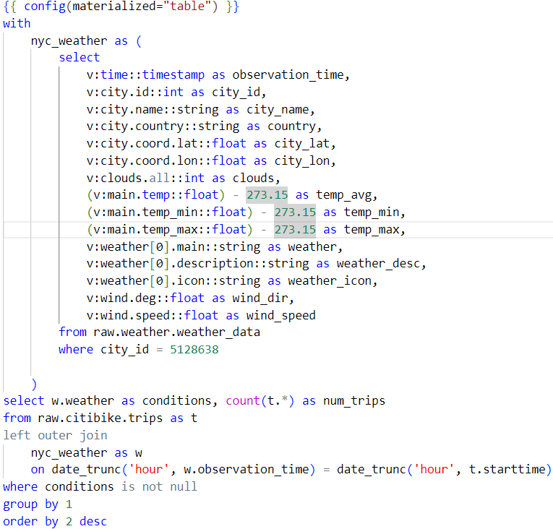
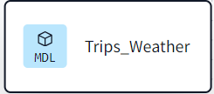
Dbt Cloud – Building your Models
The number of trips by weather condition
Trips
Bikes_Usage
T
Weather

Slide 15
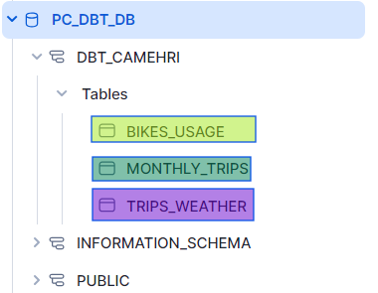
Snowflake– Analytics
External
Data Sources
Raw Data
Prepared Data
EL
T

Slide 16
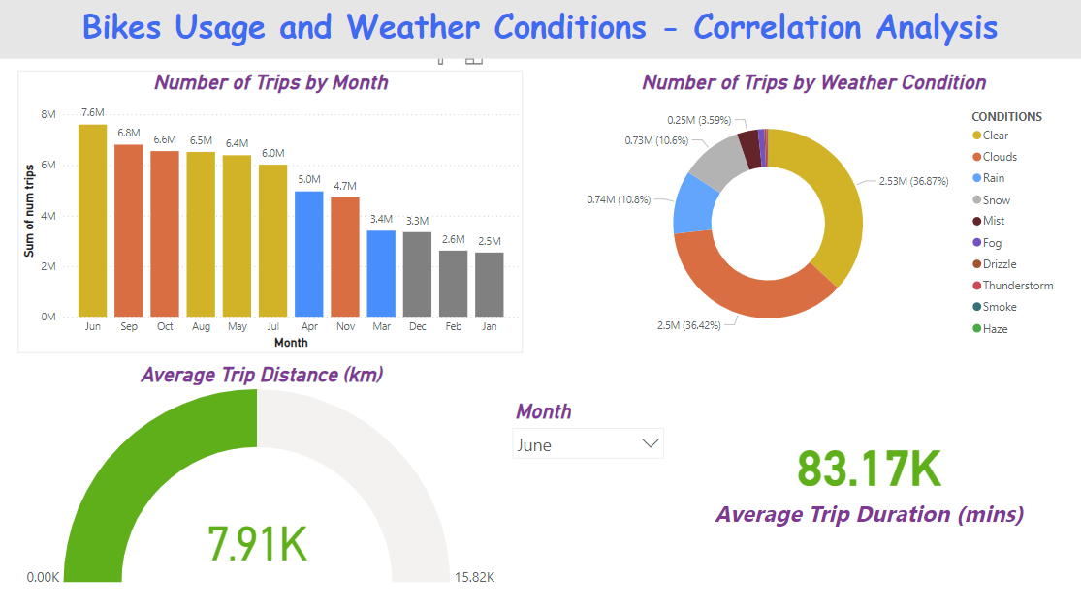
Power BI – Reporting

